Slide 1



Sri SAI RAM ENGINEERING COLLEGE
2024 INTERNATIONAL CONFERENCE ON COMMUNICATION,
COMPUTING & INTERNET OF THINGS
(IC3IoT – 2024)
Dynamic Water Quality Monitoring via IoT Sensor Networks and Machine Learning Technique
Paper ID: 198
Presenter Name
Sowmiya R
Department of Information Technology
Author Name
Mrs. Leonila T, Dr. Senthil G.A , Dr. Geerthik S, Sowmiya R & Nithish J

Slide 2
Outline
Abstract
Objectives and Scope of the project
Related work
Existing System
Proposed System
Hardware and Software Requirements
Methodology
Result
Conclusion and future work
References

Slide 3
Abstract
Integration of IoT sensor network and machine learning techniques for real-time water quality monitoring. IoT sensors placed strategically in water bodies gather multiple parameter data continuously. Machine learning algorithms on cloud infrastructure process data to detect abnormalities and forecast changes.
Predictive analytics enable proactive decision-making in response to water quality variations. ML models trained on historical data detect trends and deviations from the norm. System design ensures flexibility, scalability, and applicability in environmental protection and water resource management.
Synergy of IoT, cloud computing, and ML enhances monitoring, offering current and actionable insights. Methodology outlined for IoT sensor network deployment, cloud data processing, and ML implementation. Approach aims to provide dynamic, comprehensive assessments of water quality, addressing growing concerns.

Slide 4
Objectives of the Project
To design and implement an IoT sensor network strategically placed within water bodies and distribution networks to enable comprehensive and real-time data collection.
To implement modern machine learning algorithms to process and analyze water quality data, aiming to identify abnormalities, detect trends, and predict changes in water parameters.
To establish a system that provides continuous, dynamic monitoring of key parameters such as pH, turbidity, temperature, and dissolved oxygen, allowing for immediate responses to changes in water quality.
To evaluate the scalability of the IoT sensor network and machine learning algorithms, addressing the potential for expansion to larger networks or different geographical areas.

Slide 5
Scope of the Project
This study pioneers a transformative approach to water quality monitoring, merging IoT sensor networks with machine learning. It strategically deploys sensors in water bodies, leveraging cloud-based processing for real-time assessment. Key parameters like turbidity, temperature, and electrical conductivity are continuously monitored for dynamic insights..
The study also delves into training ML models with historical data to detect trends and anomalies. It evaluates the system's adaptability and scalability across diverse environmental conditions.
Furthermore, it explores practical applications in environmental protection and water resource management.

Slide 6
Related work
Liu, Y. et.al (2023), The combination of machine learning (ML) techniques and Internet of Things (IoT) sensor networks has been the subject of several studies aimed at improving water monitoring systems and changing the prediction, assessment, and management of water quality. Support vector machines and clustering algorithms, in particular, are machine learning models that were used to find leaks, detect anomalies, and optimize distribution networks.
Wong, Y.J et.al (2023), The combined findings of these researches highlight the potential benefits of integrating ML approaches with IoT sensor networks in water monitoring systems. They show how proactive decision-making for water quality management may be aided by early anomaly detection, resource allocation optimization, and real-time data collecting via IoT sensors and machine learning models .
R.M. Asha et.al (2022), The Internet of Things (IoT)-based Think-Speak application will use the collected data to send the data to the cloud in order to monitor the water quality under test. Future instructions could include expanding the study to analyze additional factors including electrical conductivity, dissolved oxygen in the water, free residual chlorine, and nitrates to assist in continuous water quality monitoring based on four parameters: pH, temperature, turbidity, and electric conductivity. The Arduino Uno is connected to four separate sensors to sense the quality metrics.

Slide 7
Existing System
Integrating CNN for Real-Time Water Quality Monitoring : The IoT sensor network consists of low-cost, low-power sensors deployed at various locations within the water distribution network. These sensors transmit data wirelessly to a central processing unit, where the raw data is preprocessed and fed into the CNN model. The CNN architecture is designed to extract spatial and temporal features from sensor data, enabling the detection of anomalies and changes in water quality.
Ensemble Learning Approach for Dynamic Water Quality Assessment: The system integrates data from a network of IoT sensors deployed across various water bodies and distribution networks. These sensors collect high-resolution data at regular intervals. The server hosts an ensemble of machine learning models, including Random Forests, Support Vector Machines, and Neural Networks, each trained to analyze specific aspects of water quality.

Slide 8
Proposed System
This proposed system involves the deployment of IoT sensors across water bodies and distribution networks to collect continuous data on key parameters such as turbidity, temperature, and Electrical Conductivity. The collected data is processed and analyzed using Gradient Boosting Machine algorithm, which are trained on historical data to detect patterns, anomalies, and predict future trends in water quality.
GBM algorithms are known for their high predictive accuracy and ability to handle complex datasets. By utilizing GBM, our system can provide more accurate and reliable predictions of water quality parameters compared to existing systems relying on traditional machine learning algorithms.
The integration of IoT enables real-time data collection and transmission, allowing for immediate detection of changes in water quality. This real-time capability sets our proposed system apart from existing systems that may rely on periodic sampling or manual data collection methods.

Slide 9
Hardware and Software Requirements
Hardware Components :
ESP32 Dev Kit V1
TDS Sensor
DS18B20 Temperature Sensor
DS18B20 Temperature Sensor Terminal Adaptor
ADS1115 16 bit ADC Module
0.96 " I2C OLED Display
Breadboard
Jumper Cables
Software Components :
Microsoft Excel
Tableau
Arduino IoT cloud Editor

Slide 10
Methodology
IoT Sensor Deployment : IoT sensor deployment in water quality follows strict requirements, in compliance with regulations. Water bodies are fully covered by strategically placed sensors that measure things like turbidity, temperature, and Electrical Conductivity.
Data Acquisition and preprocessing : The process of gathering data for water quality standards entails a methodical gathering of information from various sources, such as Internet of Things sensors, labs, and remote sensing devices. To guarantee correctness and consistency, preprocessing includes verifying, cleaning, and syncing raw data.
Machine Learning Model Development : Models for machine learning (ML) are essential for predicting and evaluating a range of factors. metrics depending on certain inputs. A monitoring system with numerous sensors to measure several quality factors, such as turbidity, pH value, water level in the tank, wetness of the surrounding environment, and water temperature, was proposed by Pasika and Gandla .

Slide 11
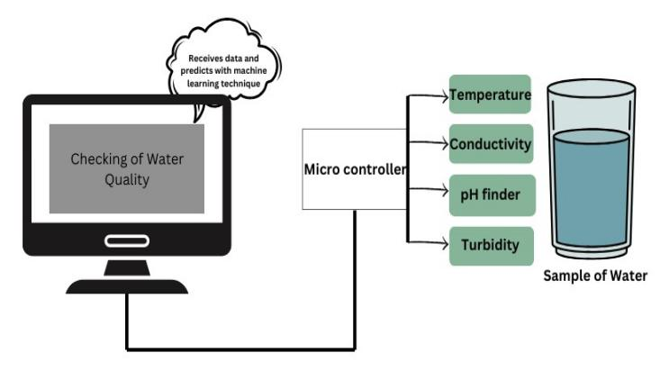
Methodology
Working Aspects

Slide 12
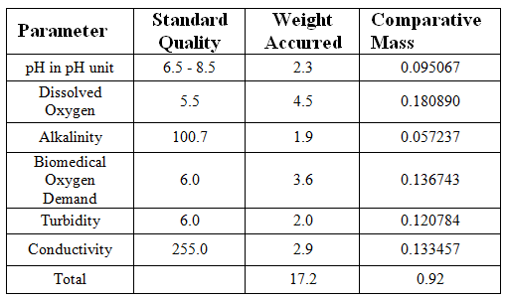
Methodology
Water Quality Parameters

Slide 13
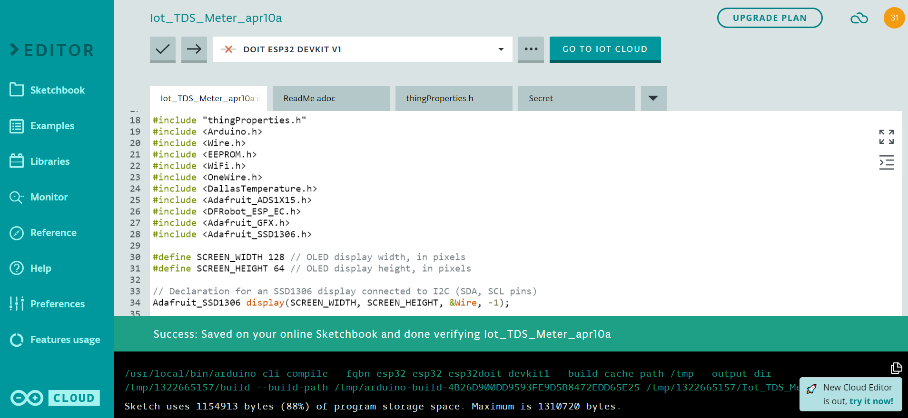
Implementation

Slide 14
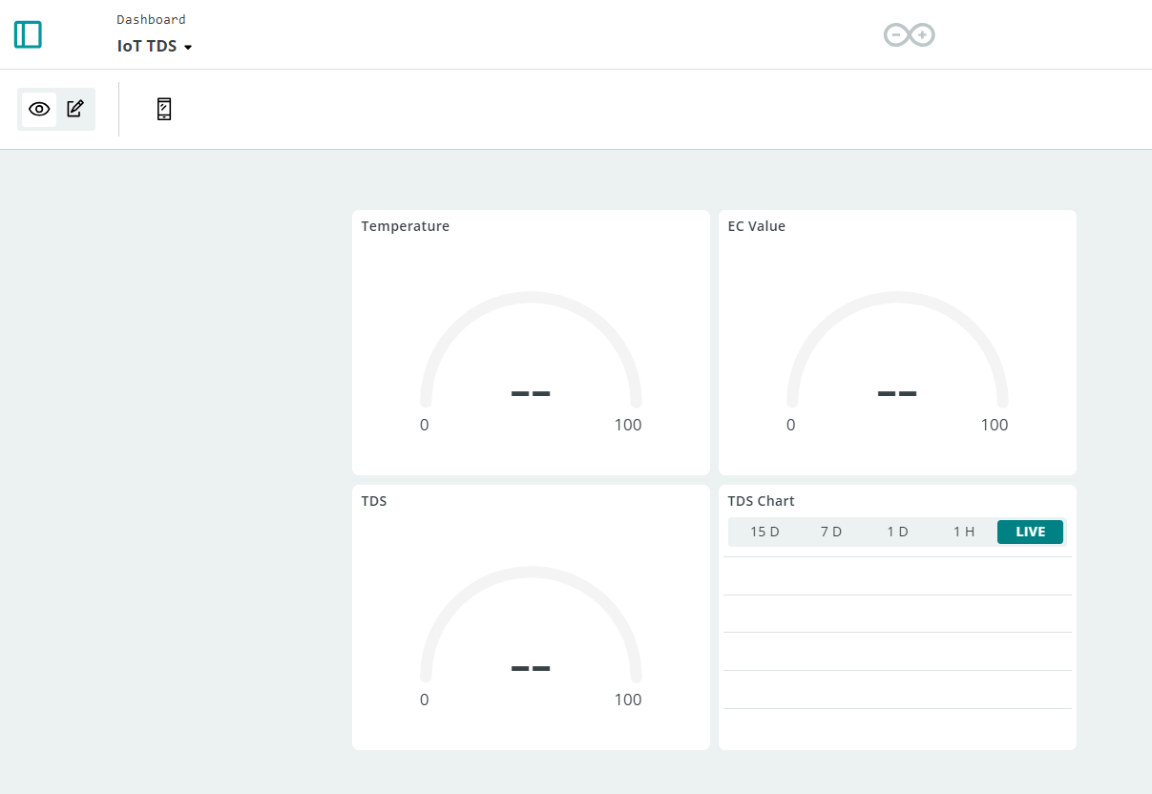
Result
Dashboard for the analysis of IoT TDS Meter

Slide 15
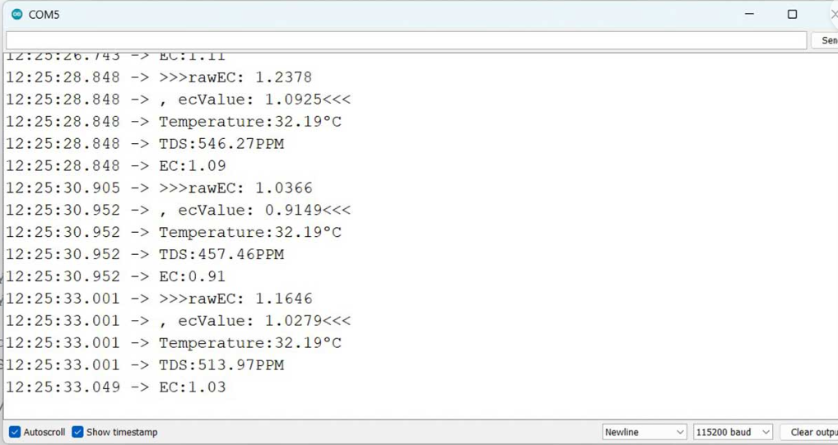
Result
Once the code is uploaded to the ESP32 board, it will attempt to connect to the designated WiFi network. After establishing a connection, it will begin reading the TDS, EC, and temperature values from the sensor. You can monitor these values by opening the Serial Monitor.

Slide 16
Result
The implementation of IoT sensor networks and machine learning algorithms significantly enhances the accuracy and timeliness of water quality monitoring. Real-time data collection and processing allow for immediate detection of changes or anomalies.
By analyzing historical data and continuously monitoring key parameters, the system can establish early warning systems for potential water quality issues. This proactive approach enables prompt interventions to prevent contamination or mitigate its impact.
The availability of comprehensive, up-to-date information empowers decision-makers in environmental agencies, water treatment facilities, and local governments to make informed decisions regarding water management and resource allocation.
By facilitating proactive interventions and informed decision-making, advanced water quality monitoring systems contribute to environmental protection efforts. Preserving water quality is crucial for ecosystem health, biodiversity conservation, and public health.

Slide 17
Conclusion and Future Work
In conclusion, our project on dynamic water quality monitoring via IoT sensor networks and machine learning techniques stands out as one of the best solutions available for addressing the challenges of water quality management. By combining advanced technologies and innovative methodologies. Collaborating with environmental agencies, water management authorities, and community stakeholders to ensure the effective implementation and adoption of the system.
Overall, our project represents a significant step forward in the field of water quality monitoring, offering an advanced and effective solution for environmental sustainability and resource management. With continued development and collaboration, our project has the potential to make a lasting impact on the protection and conservation of water resources.

Slide 18
References
Wong, Y.J.; Nakayama, R.; N. Toward industrial revolution 4.0: Development, validation, and application of 3D-printed IoT-based water quality monitoring system. J. Clean. Prod. 2021, 324, 129230.
Liu, Y.; Yu, W.; Rahayu, W.; Dillon, T. An Evaluative Study on IoT ecosystem for Smart Predictive Maintenance (IoT-SPM) in Manufacturing: Multi-view Requirements and Data Quality. IEEE Internet Things J. 2023, 10, 11160–11184.
Khan, A.A.; Beg, O.A.; Alamaniotis, M.; Ahmed, S. Intelligent anomaly identification in cyber-physical inverter-based systems. Electr. Power Syst. Res. 2021, 193, 107024.
Wu, Y.L.; Shuai, H.H.; Tam, Z.R.; Chiu, H.Y. Gradient normalization for generative adversarial networks. In Proceedings of the IEEE/CVF International Conference on Computer Vision, Montreal, BC, Canada, 11–17 October 2021; pp. 6373–6382.
Wu, J.; Yao, L., L. Combining OC-SVMs with LSTM for detecting anomalies in telemetry data with irregular intervals. IEEE Access 2020, 8, 106648–106659.
Wong, Y.J.; Shimizu, Y.; Kamiya, A.; Maneechot, L.; Bharambe, K.P.; Fong, C.S.; Nik Sulaiman, N.M. Application of artificial intelligence methods for monsoonal river classification in Selangor river basin, Malaysia. Environ. Monit. Assess. 2021, 193, 438.
Roopa, D., Babu, D. V., & Suganthi, S. (2021). Improved Cluster Head Selection for Data Aggregation in Sensor Networks. In 2021 7th International Conference on Advanced Computing and Communication Systems (ICACCS) (Vol. 1, pp. 1356-1362).
A. S. A. Nisha, S. Snega, L. Keerthana and S. Sharmitha, Comparison of Machine Learning Algorithms for Hotel Booking Cancellation in Automated Method, 2022 International Conference on Computer, Power and Communications (ICCPC), Chennai, India, 2022, pp. 413-418, doi: 10.1109/ICCPC55978.2022.10072135.
.

Slide 19
Thank You

